Slide 1
HSBC Quants Academy
Risk Management and risk types
09.03.2026
Prepared by: Jorge ROSALES

Slide 2
Table of contents
Risk Management Framework | 3
Types of Risk | 14
Cases for study and discussion | 31
Practical case: set an approval framework | 36

Slide 3
Risk Management Framework

Slide 4
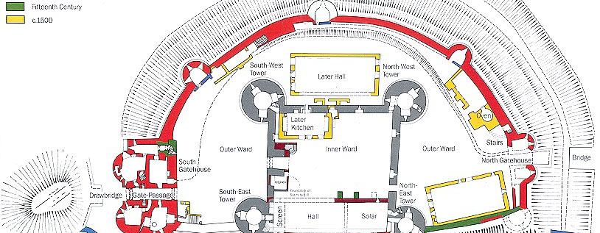
Risk Management framework – A reminder from the previous lesson
This Photo by Unknown author is licensed under CC BY-NC-ND.

Slide 5
Risk Management framework – A reminder from the previous lesson
Risks are addressed through sophisticated risk management systems, internal control system and strong corporate governance.
Risk management systems include processes established to ensure that all material risks and associated risk concentrations are:
Identified;
Measured;
Limited;
Controlled;
Mitigated;
Reported on a timely and comprehensive basis.
Internal control system is a set of rules and controls governing the bank’s organizational and operational structure, including reporting processes, and functions for:
Risk management;
Compliance;
Internal audit.
Corporate governance is a set of relationships between a company’s management, its board, its shareholders and other stakeholders which provides the structure through which the objectives of the company are set, and the means of attaining those objectives and monitoring performance. It helps define the way authority and responsibility are allocated and how corporate decisions are made.

Slide 6
Risk Management framework – Parts
Governance and structure
Defines overall risk culture in the organization
Sets the tone as how the bank implements and executes the Risk Management strategy
Strategies
Tools
Tactics
Mission
Vision
Values

Slide 7
Risk Management framework – Parts
Two main factors:
External: regulation, environment, macroeconomic and geopolitical situation
Internal: focus and Strategy Plan
Execution
Communication
of policy
Periodic
Evaluation
Risk appetite
and policy
Governance and structure
Put in practice to achieve metrics:
Source of Key appetite metrics:
HSBC 2025 annual report
Measures (all PDs, max exposure,...)
Reporting system
Thresholds to monitor and flag alerts
Clear actions if alert is flagged

Slide 8
Risk Management framework – Features of a particular risk management
Identify and assess key exposures:
  Risk Assessment, Event Management, Key Risk Indicator;
  Evaluate the risk controls: identify inherent risk and measure the residual risk after implementation of controls;
Establish clear personal accountabilities, roles and responsibilities:
  Streamlines the risk management process;
  Allows risk managers to incorporate accountability into the work culture of the organization;
Enable an efficient allocation of risk capital:
  with a streamlined risk management process, efficient risk capital allocation and utilization can be ensured;
Establish consistent and timely risk management information and reporting capabilities:
  role-based dashboards, control diagrams and scorecards help to bring high-risk areas into focus;
Ensure a continuous risk management learning:
  Helps to achieve more informed and proactive decision-making and align framework to the supported businesses;
  business units should share their experience and best risk management practices.

Slide 9
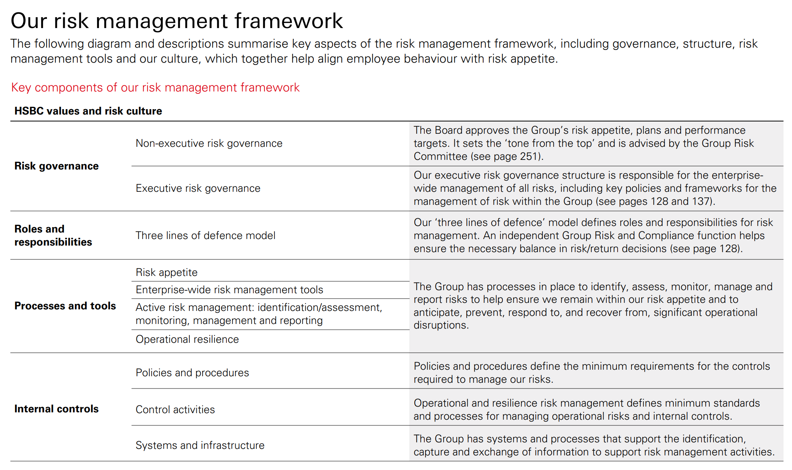
Risk Management framework – Example: HSBC Risk Management framework
Source: HSBC annual report p. 127: financial statements HSBC 2024

Slide 10
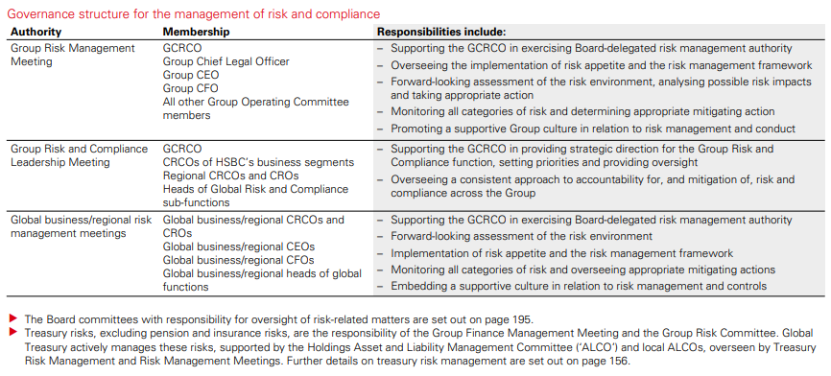
Risk Management framework – Example: HSBC Risk Management framework
Source: HSBC annual report 2025

Slide 11
Risk Management framework – Main risks associated to banking (non-exhaustive)
Financial
risks
Non-financial
risks
Transversal
risks
Market
risk
Operationalrisk
Model
risk
Credit
risk
Conduct risk
Capital
risk
Liquidity risk
Compliancerisk
Strategic risk
Reputational risk

Slide 12
Risk Management framework – Regulatory Capital
Business or Region 1
Business or Region 2
Business or Region 3
Business or Region N
Consolidated
(remember RWAs from the previous lesson?)
Capital contribution
Capital contribution
Capital contribution
Capital contribution
Capital
Market
risk
Market
risk
Market
risk
Market
risk
Market
Risk RWA
...
Credit
risk
Credit
risk
Credit
risk
Credit
risk
Credit
Risk RWA
+
Operational risk
Operational risk
Operational risk
Operational risk
Operational Risk RWA
Other
risks
Other
risks
Other
risks
Other
risks
Other
Risks RWA
Total RWA
Capital
Capital ratio =
Total RWA

Slide 13
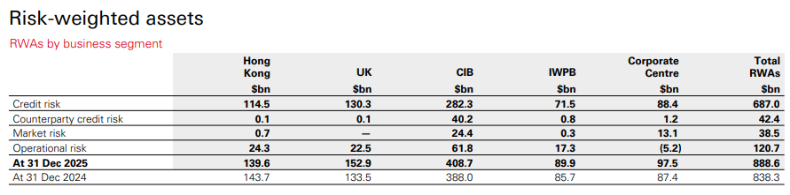
CIB = Commerical and Investment Banking
IWPB = International Wealth and Premier Banking
Source: HSBC annual report 2025

Slide 14
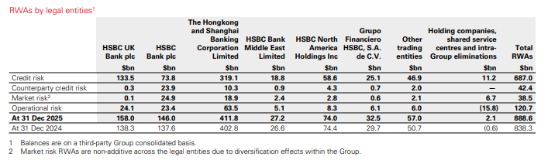
Source: HSBC annual report 2025

Slide 15
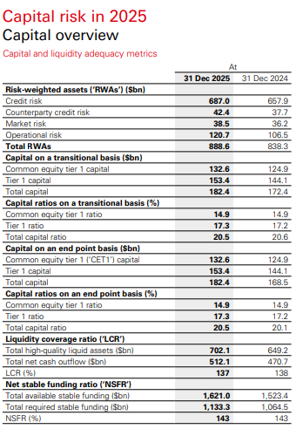
Source: HSBC annual report 2025

Slide 16
Types of risk

Slide 17
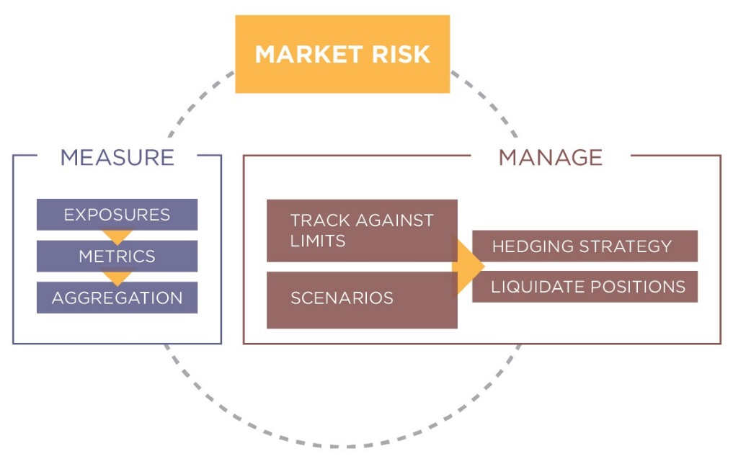
Types of Risk – Market Risk
Reminder from the previous lesson:
Examples of risks included in market risk:
Interest rate;
Equity;
Foreign exchange (FX);
Commodities.
Some important market risk management terminology:
Standardized approach (SA);
Internal models approach (IMA);
Value at Risk (VaR);
Expected Shortfall (ES);
Monte-Carlo simulation;
Counterparty Credit Risk (CCR);
X-Value Adjustments (XVA).

Slide 18
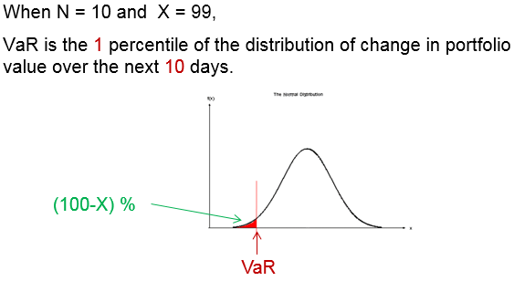
Types of Risk – Market Risk
Main measure, Value at Risk (VaR): estimation of the potential loss at a certain confidence level (X) and time horizon (e.g. N days)
Example: if the VaR at 99% and 10 days is 10.000 PLN, this means that we are 99% sure that we will not lose more than 10.000 PLN in the next 10 days

Slide 19
Types of Risk – Market Risk
VaR has a number of advantages:
It captures an important aspect of risk with a single number;
It is easy to understand: the 1% VaR is the worst outcome of the 99% best outcomes
It is easyt to calculate
VaR has a number of disadvantages:
It actually doesn’t capture the key aspect of risk: what to expect when things go wrong
It is actually extremely misleading: the 1% VaR is the *best* possible outcome of the 1% worst cases
It is actualluly not a risk measure at all (it is not a cohearent risk measure)
There are three main approaches to calculate VaR:
Parametric: the P&L is estimated by assuming that the portfolio/underlying follows a certain distribution;
Historical: the P&L is estimated using risk factors' recent history;
Monte Carlo: the risk factors are simulated and then the P&L is estimated.

Slide 20
Types of Risk – Market Risk
The VaR cannot cover all risk factors, it needs to be supplemented. Examples:
Stressed VaR: assuming historical approach, VaR only uses the recent history of the relevant risk factors. Stressed VaR uses the history during the financial crisis;
Idiosyncratic Credit VaR: many positions do not have proper market data; they must be valued using a proxy, which introduces further error in the calculation. This term estimates this error;
Incremental Risk Charge: VaR does not take into account changes in credit quality of obligors (i.e. rating). This term estimates the effect of this risk factor.
Each term responds to a regulatory requirement

Slide 21
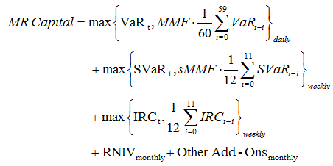
Types of Risk – Market Risk
Example of use: Market Risk Capital
Capital reporting

Slide 22
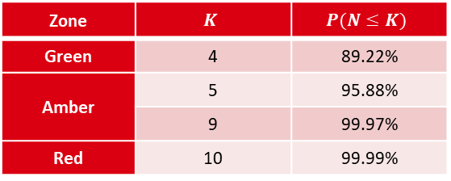
Types of Risk – Market Risk
Example of use: VaR breaches
Levels for 250 observations at a 99% level
Zone
Green | 4 | 89.22%
Amber | 5 | 95.88%
 | 9 | 99.97%
Red | 10 | 99.99%

Slide 23
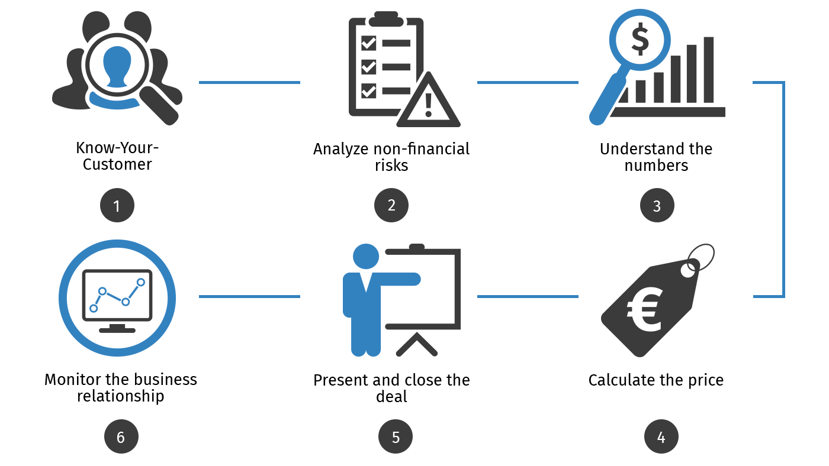
Types of Risk – Credit Risk
Reminder from the previous lesson:
Some ways to mitigate credit risk:
Risk-based pricing;
Covenants;
Credit insurance and credit derivatives;
Guarantee from a third party;
Tightening (e.g. reducing exposure amount or payment terms);
Diversification;
Collateral.
Some important credit risk management terminology:
Standardized approach (SA);
Internal Risk Based approach (IRB);
Expected Losses (EL);
Probability of Default (PD);
Loss Given Default (LGD);
Exposure at Default (EAD).

Slide 24
Types of Risk – Credit Risk
Two main blocks:
Retail: it involves typical day to day products
Mortgages
Credit cards
Car or Student loans
Wholesale: the focus is on big companies
Project finance
Working capital management
Commercial real estate
And in the middle, the small & medium enterprises (SME), which have a bit of both

Slide 25
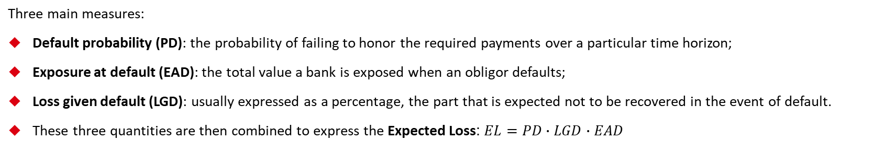
Types of Risk – Credit Risk

Slide 26
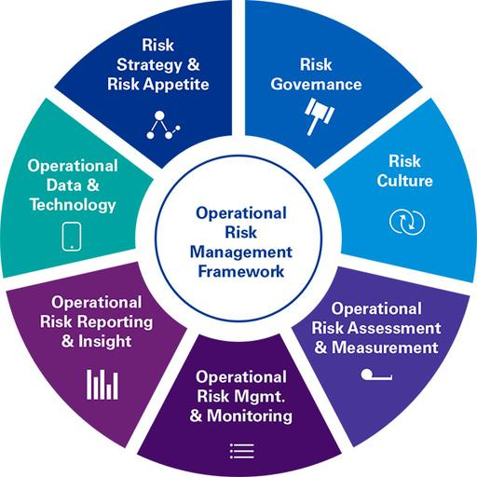
Types of Risk – Operational Risk
Reminder from the previous lesson:
Types of operational risk events:
Internal fraud;
External fraud;
Employment practices and workplace safety;
Clients, products and business practices;
Damage to physical assets;
Business disruption and system failures;
Execution, delivery and process management.
Some important operational risk management terminology:
Basic indicator approach (BIA);
Standardized approach (SA);
Advanced measurement approaches (AMA);
The Business Indicator (BI);
The Internal Loss Multiplier (ILM);
Scenarios Analysis;
Loss Distribution Approach (LDA).

Slide 27
Types of Risk – Operational Risk
Type of risk | Example
Internal fraud | Hide positions intentionally to report less exposure
External fraud | Phishing mails to steal information
Employment practices and workplace safety | Electric shock because of a non-working plug
Clients, products and business practice | Accidental leak of customer personal data
Damage to physical assets | Non-operative site because of a blackout
Business disruption and systems failures | Communication infrastructure break due to accident
Execution, delivery and process management | Fat finger trade

Slide 28
Types of Risk – Operational Risk
Example of use: Expected Potential Loss
It is easily understood with an example:
Frequency of an event: throughout the previous year there were 204 attempts to steal money from case desks in its branches;
Severity of an event: on average, the amount of stolen cash was 1.534 PLN;
Expected Potential Loss: in this case, the annual Expected Potential Loss from this particular type of operational risk event is EPL=1.534 * 204 = 312.936 PLN.

Slide 29
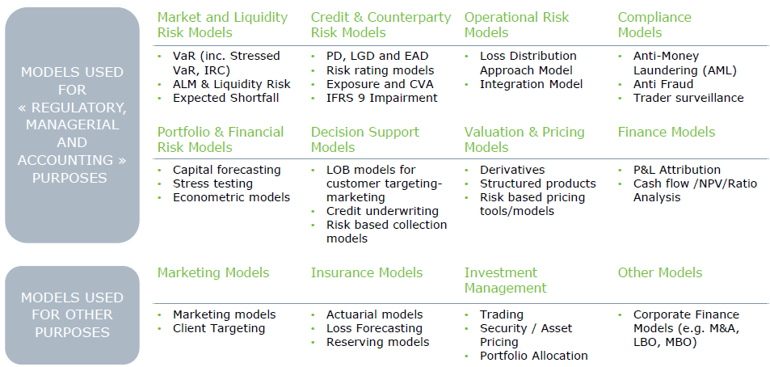
Types of Risk – Model Risk
A large bank has a wide range of model types subject to governance and model risk management
Source: Deloitte – Model Risk Management

Slide 30
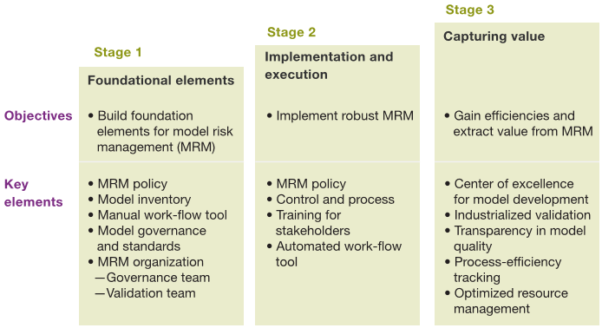
Types of Risk – Model Risk
Setting a Model Risk Management Framework goes beyond a regulatory or administrative task:
Source: McKinsey – The evolution of Model Risk Management

Slide 31
Types of Risk – Model Risk
A common approach is the called Three lines of defence:
First Line of Defence
Model Development / Use
Second Line of Defence
Model Validation / Control
Third Line of Defence
Internal Audit
Complete ownership of models
Design and implementation
Introduce infrastructure for effective implementation
Post implementation and testing
Ongoing monitoring of performance
Independence from First Line of Defence
No co-development of models. If there is a case, it must be explicitly documented to avoid parciality
Analysis of all model areas (design, implementation, documentation,...)
Stricter controls and documentation standards
High level of independence from First and Second line of Defence.
Assessment of both First and Second line, including how they interact during Model Validation
Less focus on model content and more on processes and controls
Conclusions directly reported to Senior Management and Board

Slide 32
Types of Risk – Other types of Risk
Liquidity risk:
  From the Markets side, Liquidity risk arises when for a certain period of time a given financial instrument cannot be traded quickly enough in the market without impacting the market price;
  From the Credit side, Liquidity Risk is the risk that a business will have insufficient funds to meet its financial commitments in a timely manner
Climate Change
Reputational risk: risk of loss resulting from damages to a firm's reputation, due to adverse or potentially criminal event, even if the company is not found guilty. It could have many consequences:
  loss in revenue or in customers;
  increased operating, capital or regulatory costs;
  destruction of shareholder value.
So far, we have seen only the most important and relevant for Banking. There are many more!

Slide 33
Cases for study and discussion

Slide 34

The CDS trader
Reading time

Slide 35

The CDS trader
Discussion time

Slide 36
The preferred stock issue
Reading time

Slide 37
The preferred stock issue
Discussion time

Slide 38
Practical case: set an approval framework

Slide 39

An approval framework
Thinking time

Slide 40
An approval framework
Discussion time

Slide 41
Disclaimer
This presentation has been prepared by HSBC Service Delivery (Polska) sp. z o.o. with a registered office located at Kapelanka 42A, 30-347 Krakow, Poland, registered in the District Court for Kraków-Śródmieście in Kraków, XI Commercial Division of the National Court Register, under the number KRS 0000310459, share capital (entirely paid) in the amount of 67 689 500,00 PLN, NIP 525-242-91-07, hereinafter referred to as “HSBC”.
HSBC has based this document on information obtained from sources it believes to be reliable but which has not been independently verified. While this information has been prepared in good faith, no representation or warranty, express or implied, is or will be made and no responsibility or liability is or will be accepted by the HSBC, or by any of their respective officers, employees or agents in relation to the accuracy or completeness of the Documents or any other written or oral information made available to any interested party or its advisers and any such liability is expressly disclaimed. Any charts and graphs included are from publicly available sources or proprietary data. No liability is accepted whatsoever for any direct, indirect or consequential loss arising from the use of this document. HSBC is under no obligation to keep current the information in this document. You are solely responsible for making your own independent appraisal of and investigations into the data, products, financial instruments and transactions referred to in this document and you should not rely on any information in this document as constituting investment advice. Neither HSBC nor any of its affiliates are responsible for providing you with legal, tax or other specialist advice and you should make your own arrangements in respect of this accordingly. The issuance of and details contained in this document, which is not for public circulation, does not constitute an offer or solicitation for, or advice that you should enter into, the purchase or sale of any security, commodity or other financial instrument or master agreement, or any other contract, agreement or structure whatsoever. This document is intended to be distributed in its entirety. Reproduction of this document, in whole or in part, or disclosure of any of its contents, without prior consent of HSBC or any associate, is prohibited.

